Slide 1
Tableau exploer_data
Geographically

Slide 2
Assignment :-
1. Create a Map view to represent all the states with country.
2. Check your map for south region.
3. Check the sales for south region.
4. Find the state that has highest sales.
5. Represent your sales in USD.
6. Edit color for you map.
7. Show profit for all the states in your map in south region.
8. Find out the name of some states having negative profit.
9.Note down the name of the states having lowest profit and highest profit.

Slide 3
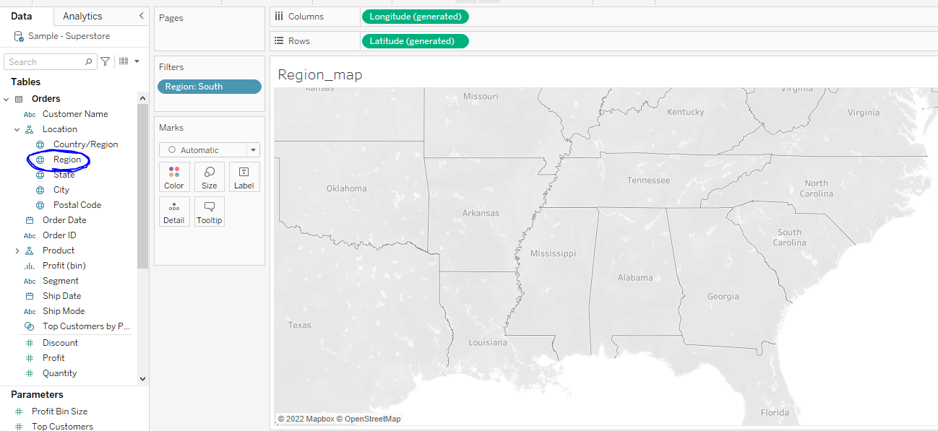
1)create a map to all states with country.

Slide 4
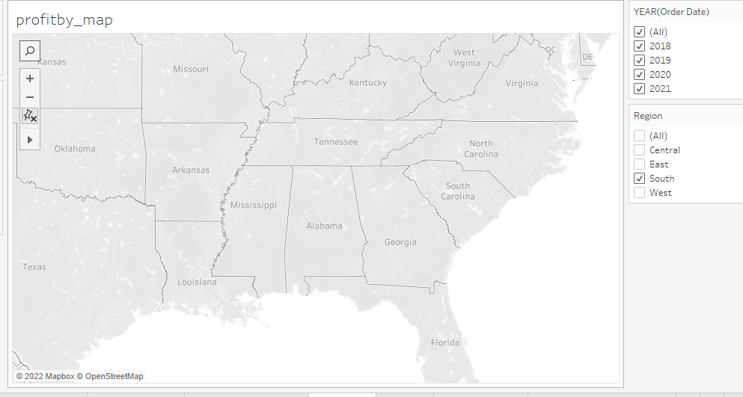
2)check map with your south region.

Slide 5
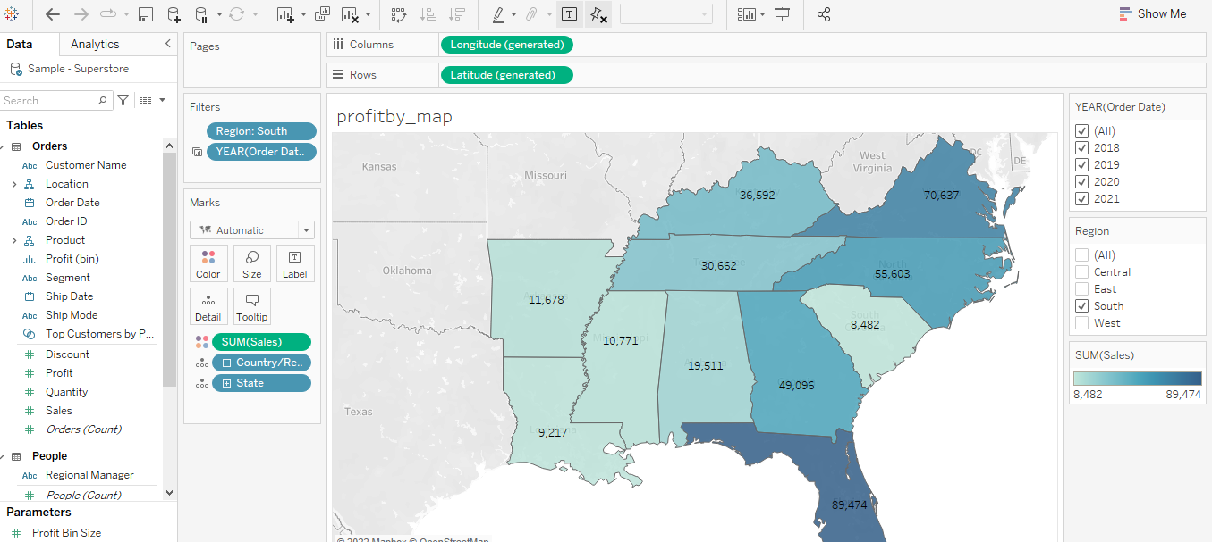
3)check the sales for south region.

Slide 6
4)find the state that has highest sales.
Highest sales in florida, lowest sales in carolina

Slide 7
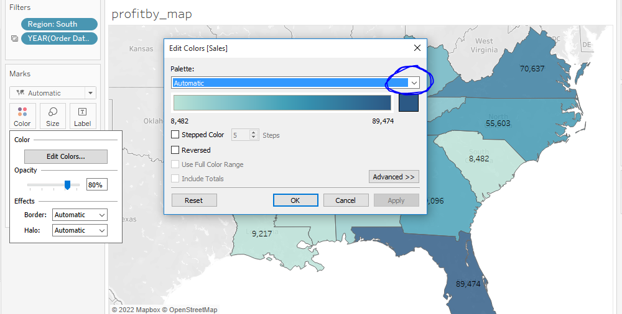
5)edit color your map.

Slide 8
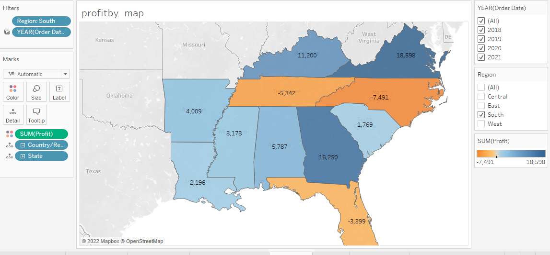
6)show profit for all the states in map in south Region.

Slide 9
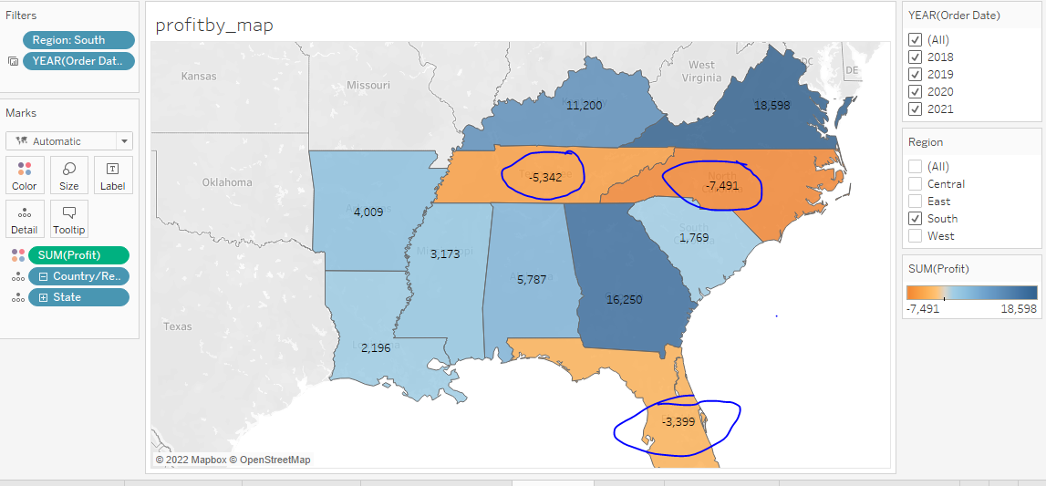
7)find the name of states having negative profit
1.Tennesee, 2.north carolina, 3.florida

Slide 10
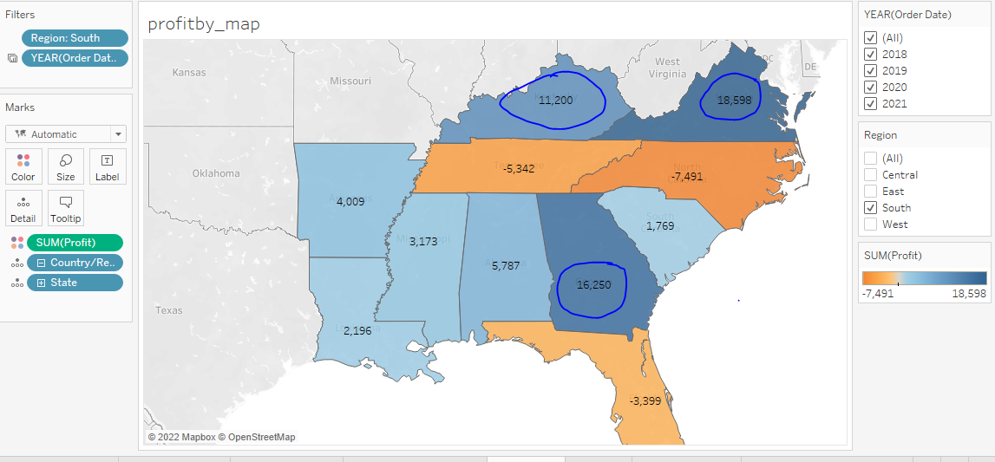
Note down the name of highest profit.
1.veriginia, 2)Georgia, 3)kentucky.

